Slide 1
More Recursion

Slide 2

Announcements
TODO Reminders:
Readings are due before lecture
Reading 25 (zybooks) – you should have already done that ☺
Lab 16
Reading 26 (zyBooks)
Lab 17
RPA 12
Keep practicing your RPAs in a spaced and mixed manner ☺
https://www.brainyquote.com/quotes/katherine_johnson_875699
Help Desk
Day | Time : Room
Monday | 12 PM - 2 PM : CSB 120
Tuesday | 6 PM - 8 PM : Teams
Wednesday | 3 PM - 5 PM : CSB 120
Thursday | 6 PM - 8 PM : Teams
Friday | 3 PM - 5 PM : CSB 120
Saturday | 12 PM - 4 PM : Teams
Sunday | 12 PM - 4 PM : Teams

Slide 3
Recall Activity
import java.util.Scanner; public class Recursion { public static void recursiveCall(int number, int lowVal, int highVal) { int midVal; midVal = (highVal + lowVal) / 2; System.out.print(number); System.out.print(" "); System.out.print(midVal); if (number == midVal) { System.out.println(" f"); } else { if (number < midVal) { System.out.println(" l"); recursiveCall(number, lowVal, midVal); } else { System.out.println(" h"); recursiveCall(number, midVal + 1, highVal); } } }
public static void main(String[] args) { Scanner scnr = new Scanner(System.in); int number; number = scnr.nextInt(); recursiveCall(number, 0, 10); } }
What does this program do?
Write down each recursive call and its parameter and return value for number = 3

Slide 4
Recursion Review, Recursion Review…
Recursion
A way to ‘repeat’ code without loops
Methods that call themselves
Recursive methods have
A base case (condition to stop)
recursive call
return values (good design)
Example from challenge problems
another way to reverse string
public static String stringManipulator(String str) { if (str.isEmpty()) return str; return stringManipulator(str.substring(1)) + str.charAt(0); }
base case
recursive call

Slide 5
Visualizing This Method
public static String stringManipulator(String str) { if (str.isEmpty()) return str; return stringManipulator(str.substring(1)) + str.charAt(0); }
str = gem
stringManipulator(“em”)
g
=
meg
stringManipulator(“m”)
e
=
me
stringManipulator(“”)
m
=
m
“”

Slide 6
The Memory Stack
Math factorials
N = 6, factorial is 1 * 2 * 3 * 4 * 5 * 6
When calling methods
method is pushed onto the memory stack
removed when done
This causes the following to happen in memory
You will cover this more in CS 270 and CS 220
public static int factorial(int n) { if(n <= 1) return 1; return n * factorial(n-1); }
public static void main(String[] args) { System.out.println(factorial(3)); }
in progress
stack
main(String)
factorial(3)
factorial(2)
factorial(1)
1
2
6

Slide 7
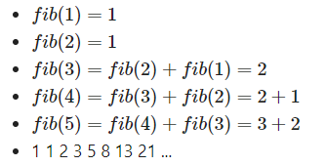
Multiple Branching
Most of our cases, the tree only had one branch that continued to branch
The other branch was always the solution
What if the tree branched out at both sides?
Fibonacci problem
The sum is equal to the previous two

Slide 8
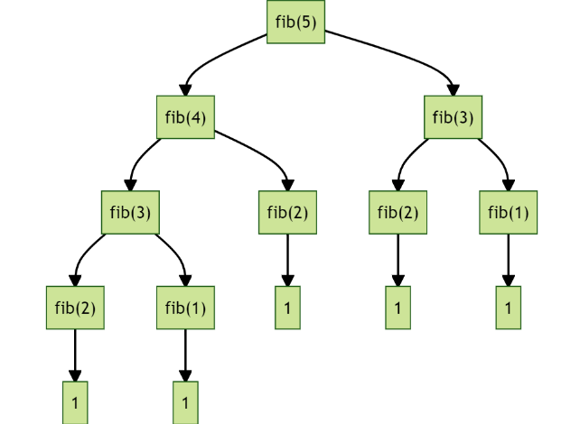
Multiple Branching
Fib(5)

Slide 9
Coding Along – Fibonacci
Write a method that calculates the fibonacci value based on n
for example:
fib(5) would return 5
fib(6) would return 8
fib(7) would return 13
and so on
Both fib(2) and fib(1) return 1, fib(0) or lower returns 0.
What is our case base?
What is our recursive call?

Slide 10
Overview
Recursion
When to use it?
When you have a limited paths to follow
When you don’t know your loop deep
When you data is already set up like a tree
you will come across it again – CS165
always remember your base case!

Slide 11
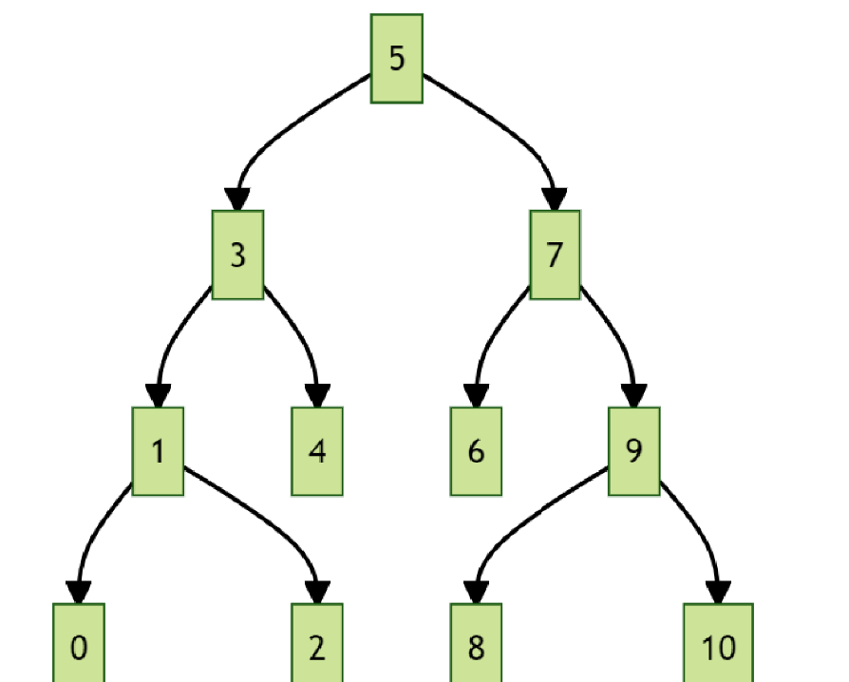
Overview
For example, let’s consider the following sequence of numbers
[0,1,2,3,4,5,6,7,8,9,10]
Numbers are ordered
We could structure this number line as a “tree”
How many movements to we need to go from 5 to 1 in this tree structure?
How many movements to we need to go from 5 to 1 in a linear structure as an array?
You will learn about tree structures on CS165 ☺

Slide 12
Practice 1
How can we change the stringManipulator method to reverse the string backwards, meaning that we start from the end instead of the begin?
Remember to think about:
base case (condition to stop)
recursive call
public static String stringManipulator(String str) { if (str.isEmpty()) return str; return stringManipulator(str.substring(1)) + str.charAt(0); }

Slide 13
Practice 2
Write a recursive method that verifies if a String is a palindrome or not. A word is a palindrome if the letters in the word are symmetric.
Remember to think about:
base case (condition to stop)
recursive call

